Slide 2


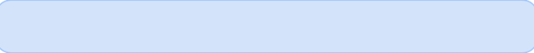
Motion Detection Alarm System
Author: Group 7
Date: June 30, 2025

Slide 3

CONTENTS
1. Introduction
2. Objectives
3. Methodology
4. Implementation
5. Output and Results
6. Conclusion and Reflection
7. References

Slide 4

01
Introduction

Slide 5


Introduction
1
This project simulates a basic home or office alarm system that detects motion or high temperature and triggers an alarm.
2
It mimics a real-life security system using Object-Oriented Programming (OOP) and GUI principles in Python.
3
Systems like these are commonly found in smart homes, commercial buildings, and industrial settings, where real-time detection of motion or hazardous environmental conditions is critical to safety and security.
4
The application acts as a simplified prototype of a physical alarm system, providing a digital environment where virtual sensors detect conditions based on configurable parameters and notify the user accordingly.
5
The simulation includes sound alerts, log tracking, and visual feedback through a user-friendly graphical interface.

Slide 6

02
Objectives

Slide 7

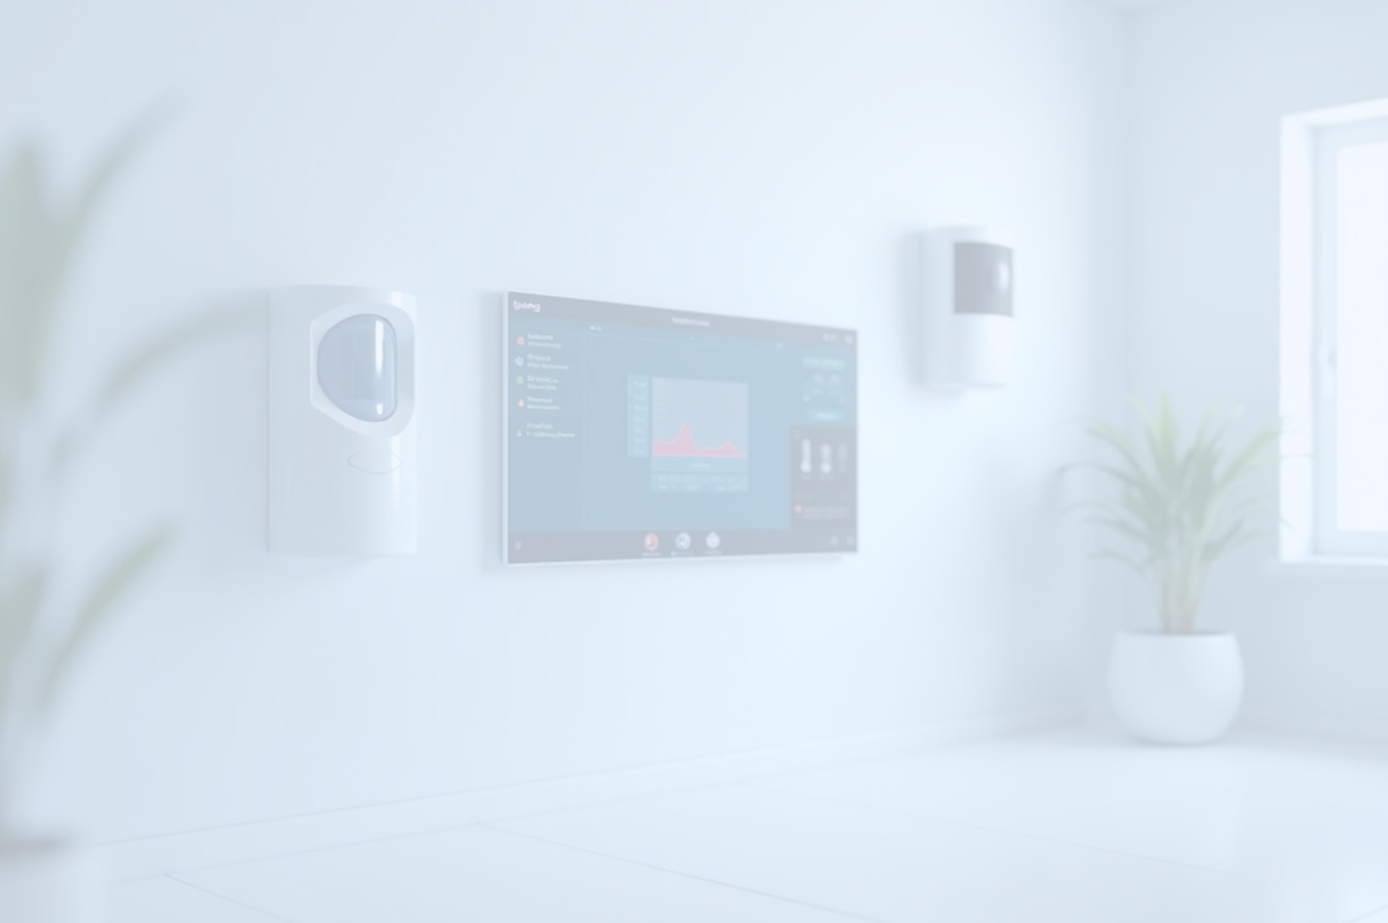
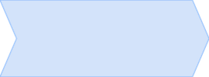

Objectives
1
2
3
4
5
Simulate a realistic alarm detection system using motion and temperature sensors.
Demonstrate practical application of key OOP principles: abstraction, inheritance, encapsulation, and polymorphism.
Provide an interactive graphical interface using tkinter to control the system.
Implement logging functionality to track and store sensor activity with real-time timestamps.
Trigger alarm sounds via pygame when critical conditions are detected.
6
Enable theme switching between light and dark modes for better usability.

Slide 8

03
Methodology

Slide 9

Main Components
Class | Description
Sensor | Abstract base class for all sensors. It enforces the presence of a detect() method for derived classes.
MotionSensor | Inherits from Sensor. Simulates motion detection using random numbers and a user-defined sensitivity level.
TemperatureSensor | Inherits from Sensor. Simulates temperature readings and returns detection based on a defined threshold.
Alarm | Contains state flags and methods to trigger or reset the alarm. Used to control alarm activation and display alerts.
MotionDetectionSystemGUI | The main GUI class that integrates sensor logic, event logging, and user controls. Also handles threading for real-time operations.

Slide 10


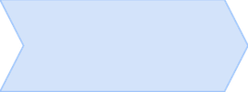
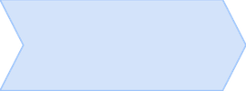
Logic and Data Flow
1
2
3
4
5
User launches the GUI and selects a sensor type from the dropdown menu.
On pressing the "Start" button, the system initializes the selected sensor and enters a background detection loop via a new thread.
The thread repeatedly checks sensor status every 2 seconds using the detect() method.
If the sensor detects an event, the alarm triggers, a sound is played, and the event is logged with a timestamp.
If no detection is found, a "No motion" or "Temperature normal" log entry is created.
6
The GUI remains interactive throughout, updating status labels and clock display in real-time.

Slide 11


Flowchart
[Start Application]
↓
[User Selects Sensor] → [Click Start Button]
↓
[Loop: Sensor.detect() every 2s]
↓
Is Detection True?
├── Yes → Trigger Alarm → Play Sound → Log Event
└── No → Log "No motion" or "Temperature normal"
↓
[Repeat Until Stopped or Exited]

Slide 12

04
Implementation

Slide 13
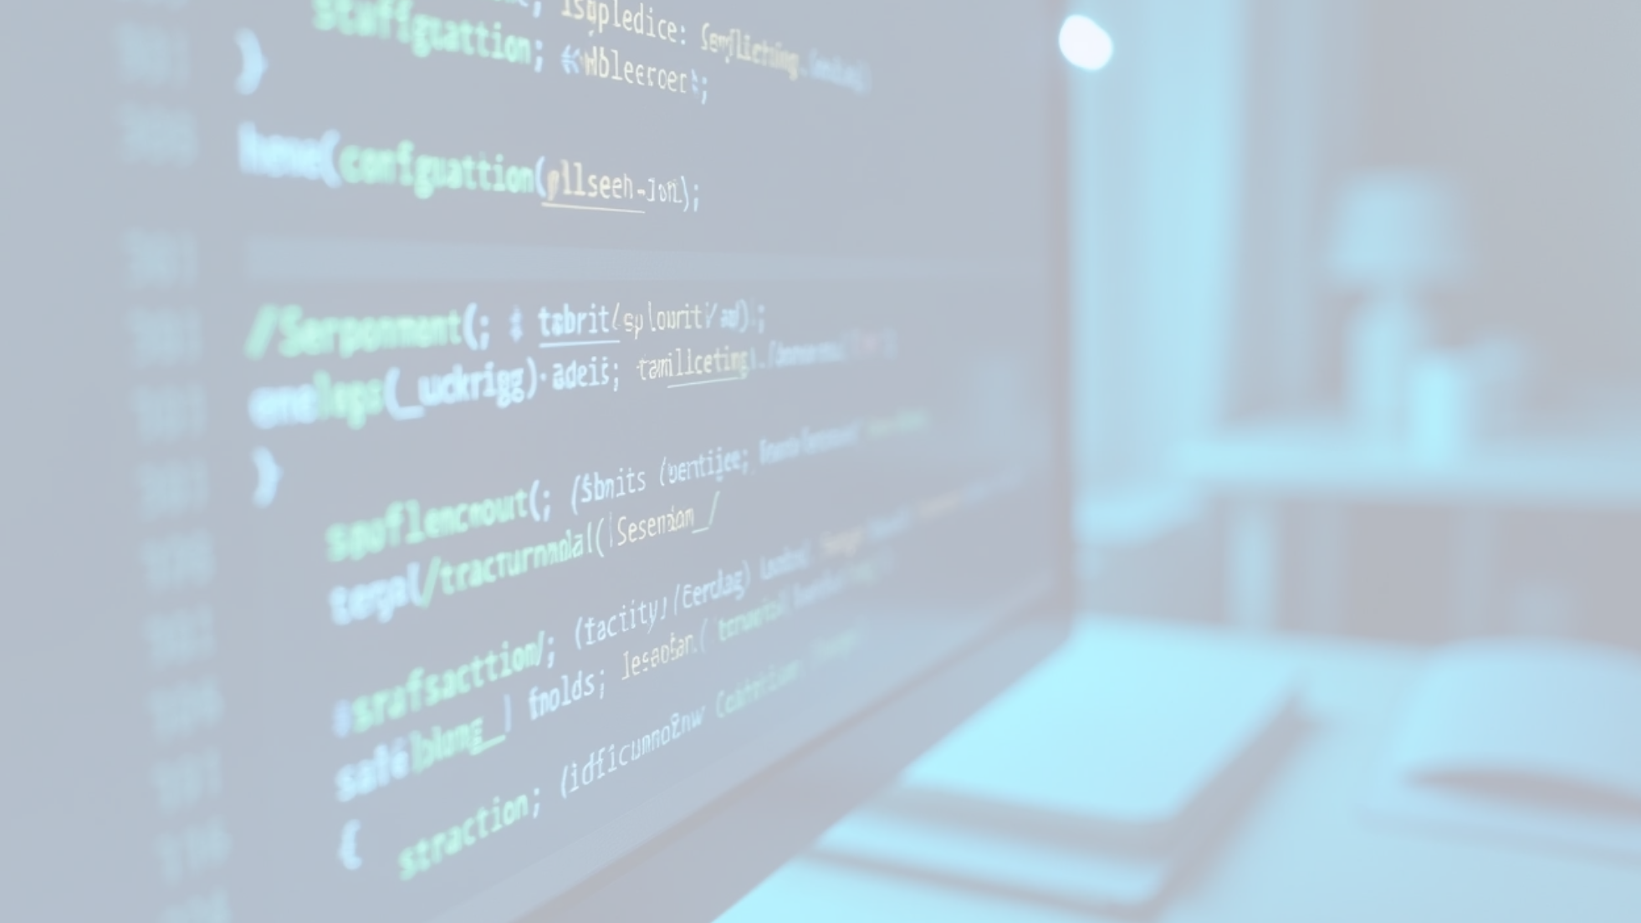
Object-Oriented Principles Used
1
Encapsulation
2
Abstraction
All sensor configurations (e.g., __sensitivity, __threshold) and alarm state variables are marked private using double underscores to prevent direct access.
The Sensor class is declared abstract using the ABC module and requires subclasses to implement detect(), enforcing a common interface.
3
Inheritance
4
Polymorphism
MotionSensor and TemperatureSensor are both subclasses of Sensor, inheriting its properties and interface.
Although each sensor class implements its detect() method differently, the main system treats all sensors uniformly via their shared interface.

Slide 14
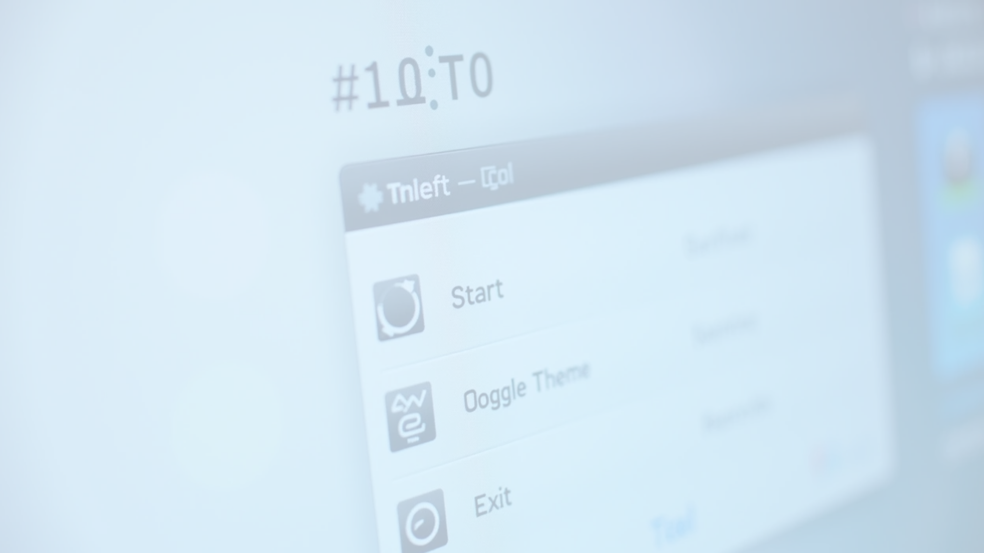
GUI Elements (tkinter)
Header Label: Displays application name and branding.
Status Panel: Shows current system state (Idle, Running, Motion Detected).
Clock Display: Updates every second using after() method.
Buttons:
• Start: Begins the detection loop.
• Stop: Halts the detection and resets status.
• Toggle Theme: Switches between light and dark modes.
• Exit: Closes the program and logs the exit.
Dropdown Menu: Allows the user to choose between motion and temperature sensors.
ScrolledText Log Area: Displays a real-time, scrollable log of system activity with time stamps.

Slide 15

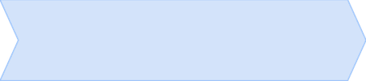

Alarm Sound
1
2
3
Utilizes pygame.mixer.init() and pygame.mixer.music.load() to play the alarm sound (alarm.wav).
Playback is handled inside the detection thread so that the GUI thread remains responsive.
The alarm stops automatically once the playback is finished.

Slide 16

05
Output and Results

Slide 17

Example Log Output
[2025-06-29 22:45:12] System started.
[2025-06-29 22:45:14] No motion.
[2025-06-29 22:45:16] Motion detected!
[2025-06-29 22:45:18] No motion.
[2025-06-29 22:45:20] System stopped.
[2025-06-29 22:45:22] System exited by user.

Slide 18

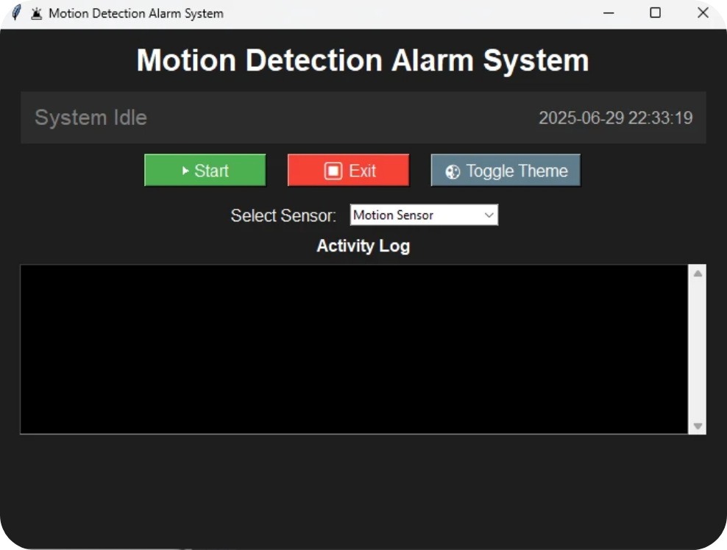
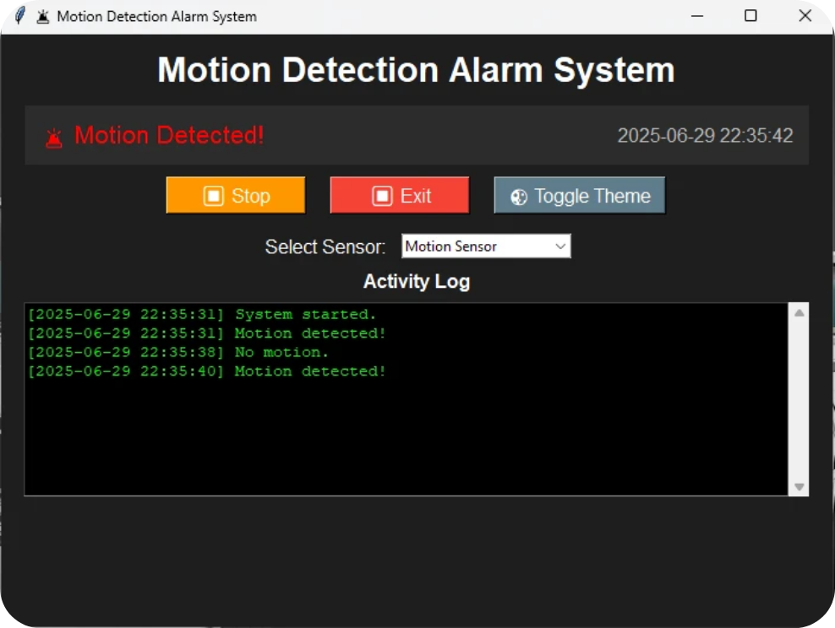
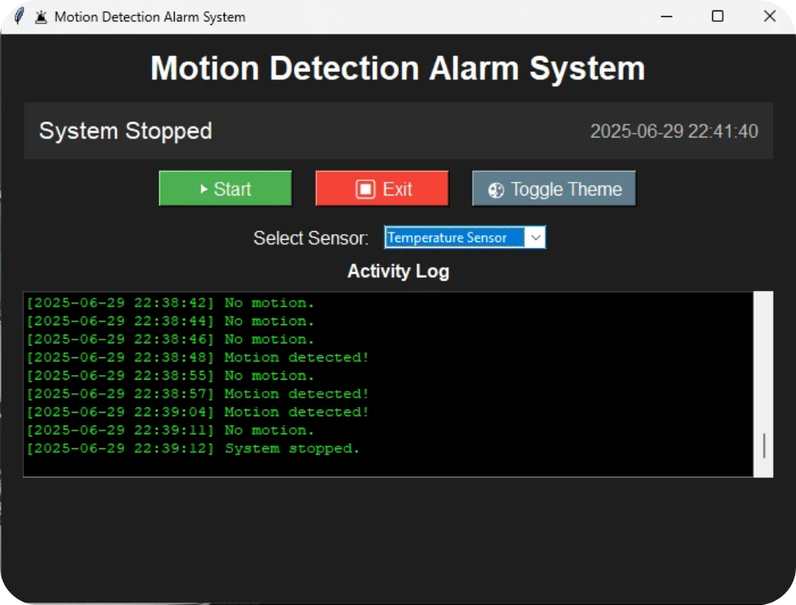
Screenshots
1
2
3
4
5
GUI in Idle State\
GUI while System is Running\
"🚨 Motion Detected!" or High Temperature Triggered\
Activity Log Box\
Light Theme Interface Example\
An activity log will be saved as a text document named “motion_log” in the same folder upon exit of the program.
You can choose between Dark theme to Light theme according to the end-user’s preference from Toggle Theme button.

Slide 19
06
Conclusion and Reflection

Slide 20

Conclusion and Reflection
This project effectively demonstrates the application of Object-Oriented Programming in the context of a real-time system.
It also highlights the integration of GUI components, event-driven programming, and asynchronous operations to simulate a complete alarm monitoring system.

Slide 21

Key Learnings
1
The importance of designing reusable and modular classes using OOP.
2
How to keep a GUI responsive using threading and asynchronous calls.
3
How to synchronize GUI updates, logging, and background operations effectively.
4
Leveraging built-in libraries like tkinter and third-party tools like pygame for full system interaction.

Slide 22


Challenges Encountered
Ensuring thread safety while updating GUI widgets.
Managing audio playback within the detection thread without blocking the interface.
Designing an intuitive yet functional layout for both novice and technical users.

Slide 23
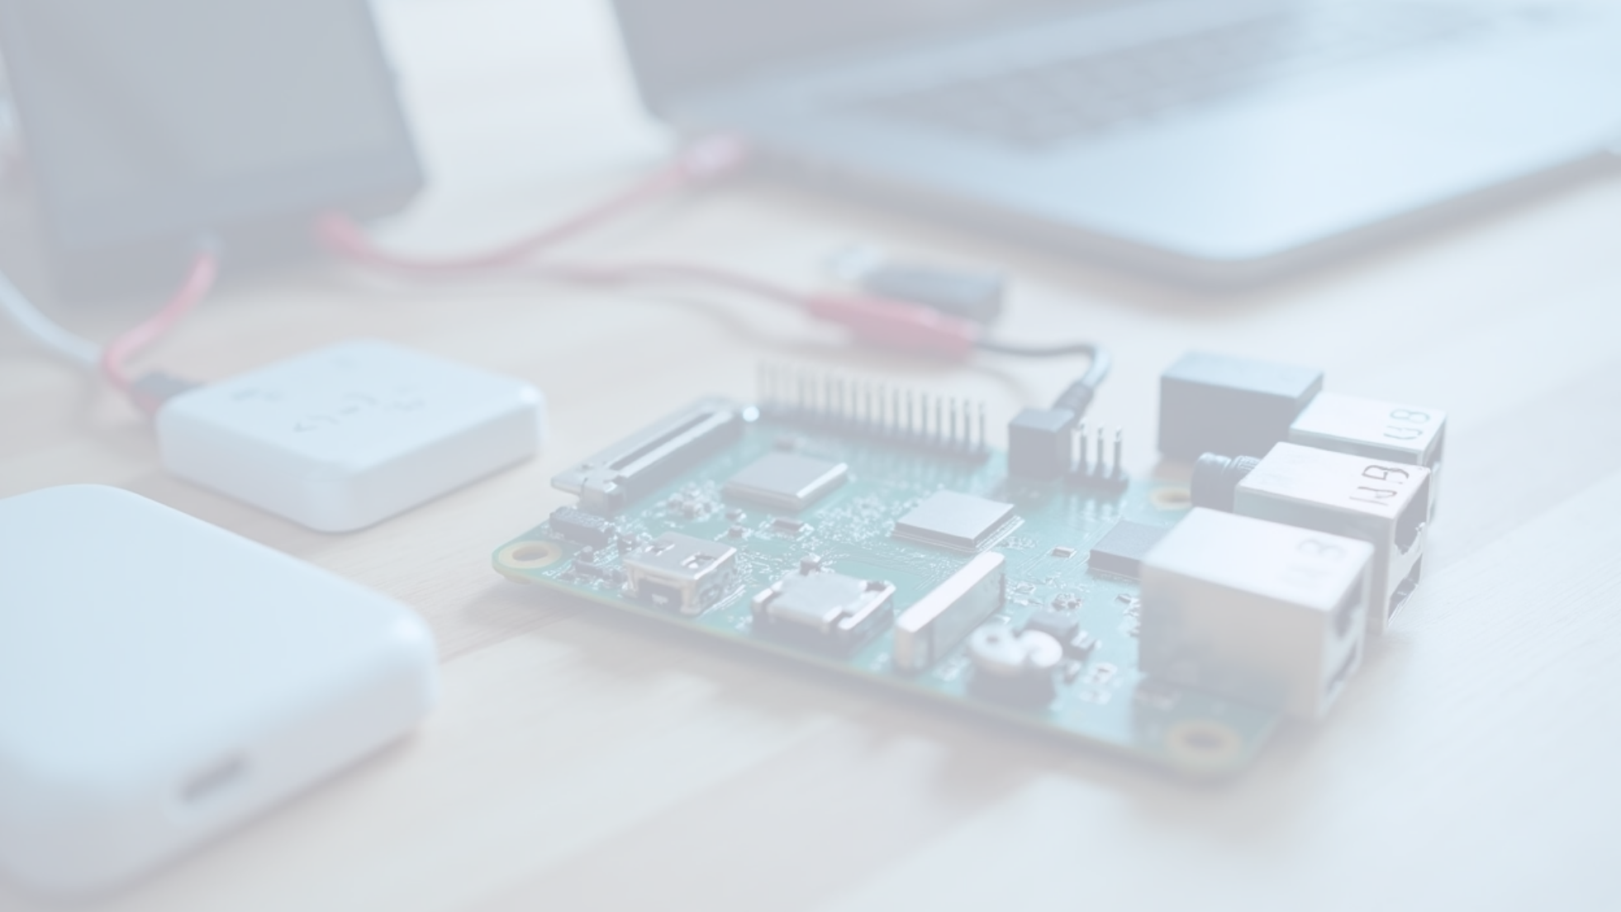
Future Improvements
1
2
3
4
5
Add support for external hardware sensors via GPIO (e.g., Raspberry Pi).
Include multi-sensor support and simultaneous monitoring.
Implement a historical database for storing logs and generating weekly activity reports.
Add real-time notification features (SMS/email alerts).
Build user profiles and login system for access control.

Slide 24
07
References

Slide 25

References
1
Python official documentation: https://docs.python.org/3/
2
tkinter GUI library: https://docs.python.org/3/library/tkinter.html
3
pygame mixer for sound: https://www.pygame.org/docs/
4
Built-in modules used: threading, datetime, random, abc
5
Real Python: https://realpython.com/python-interface/
6
TutorialsPoint Python OOP concepts: https://www.tutorialspoint.com/python/python_classes_objects.htm
Thanks for the opportunity in presenting our Group Project, we are Group 7 of BSCPEOUMN 1-2. In behalf of all the members good day and have a nice weekend Sir!

